Slide 1
Hoofdstuk 15 deel 2a DNA-repair & Genome Dynamics, Transposons

Slide 2
Mutations can be caused by:
Replication errors / slippage
Oxidative damage (reactive oxygen species)
Transposons
Viruses
Tautomeric shifts
Depurination and deamination
Chemicals and radiation
- Base analogs
- Alkylating agents
- Intercalating agents (dyes)
- Adduct-forming agents
- UV-light (thymine dimers)
- Ionizing radiation
Herhaling vorige les

Slide 3
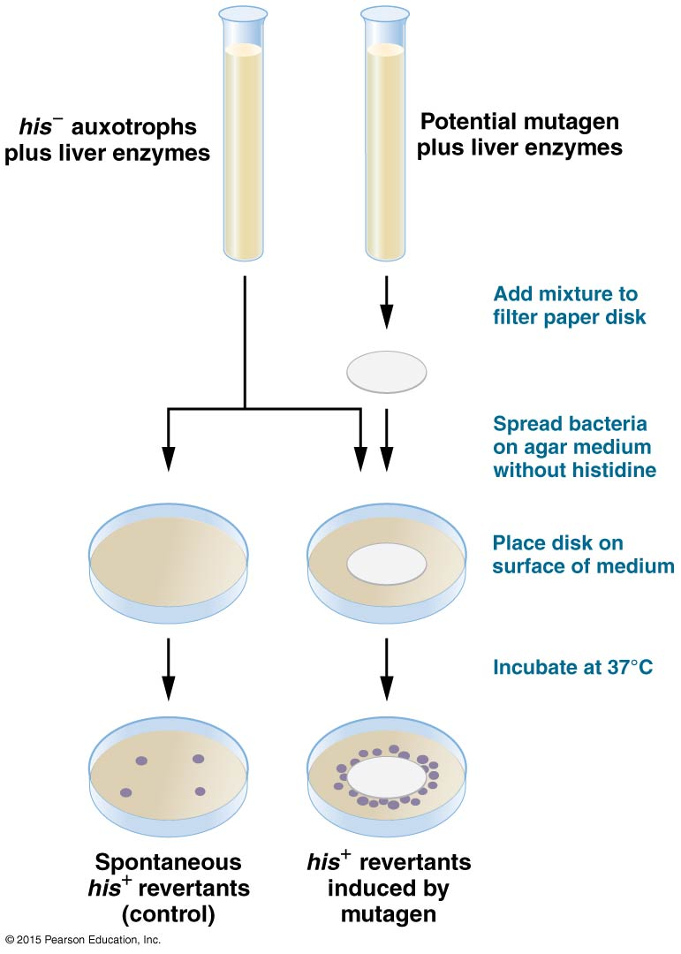
Ames test
to test the mutagenicity of compounds
Notes:
Salmonella typhimurium
his auxotroph
Test measures the reversion of the mutation. Ability to grow on medium lacking histidine
Mutaties in DNA
Reparatie genen.
Extra gevoelig
Stammen voor:
Substituties
Frame shifts
Etc.
Waarom liver enzymes?
Rat liver extract is optionally added to simulate the effect of metabolism, as some compounds, like benzo[a]pyrene, are not mutagenic themselves but their metabolic products are.^{[3]}

Slide 4
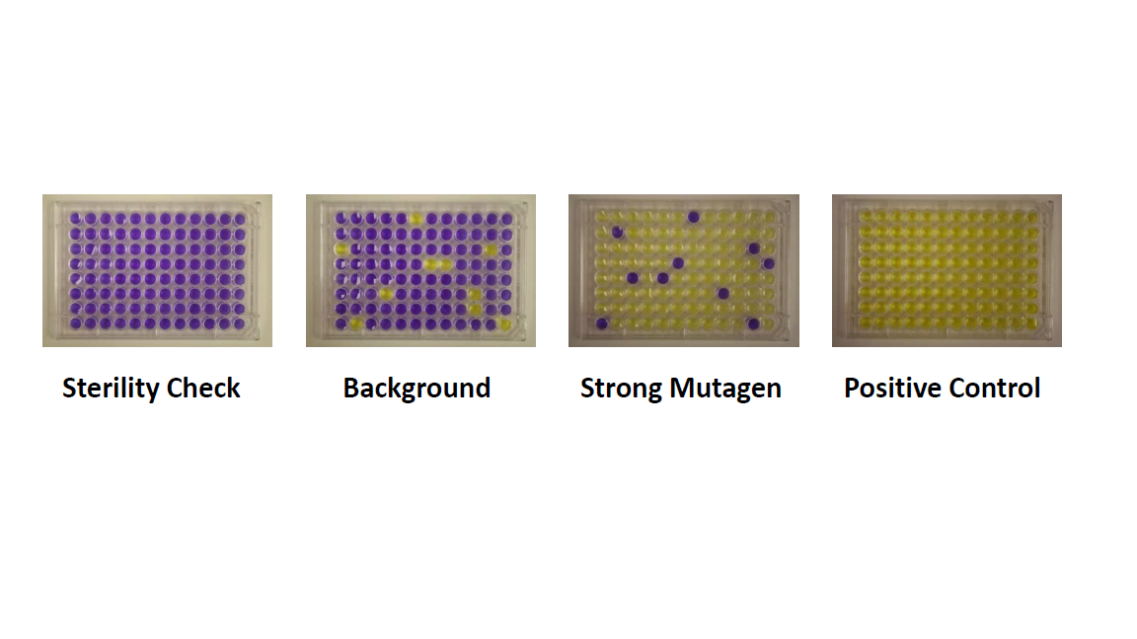
Ames test
to test the mutagenicity of compounds (concentration gradient)
Notes:
Geel: de pH is gezakt dus er is groei.

Slide 5
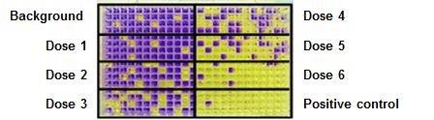
Ames test
to test the mutagenicity of compounds (concentration gradient)

Slide 6
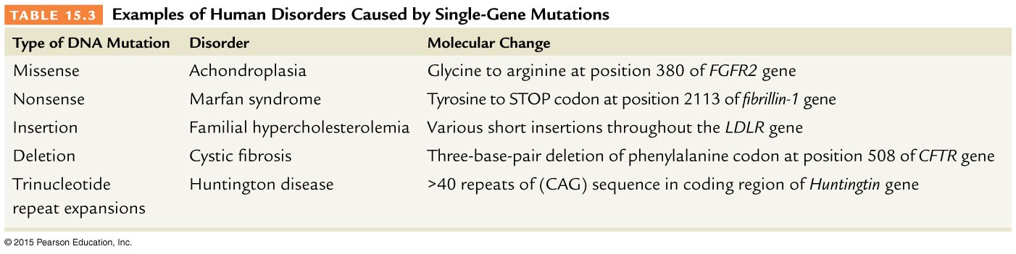
Opdracht
Single-Gene mutation → Diseases
? 1
? 2
Missense mutation
Nonsense mutation
Silent mutation
Pointmutation
Notes:
Achondorplasie: dwerggroei.
FGFR2:
Achondroplasia is caused by a mutation in Fibroblast growth factor receptor 3 (FGFR3). In normal development FGFR3 has a negative regulatory effect on bone growth. In achondroplasia, the mutated form of the receptor is constitutively active and this leads to severely shortened bones. The effect is genetically dominant, with one mutant copy of the FGFR3 gene being sufficient to cause achondroplasia, while two copies of the mutant gene are invariably fatal (recessive lethal) before or shortly after birth (known as a lethal allele). A person with achondroplasia thus has a 50% chance of passing dwarfism to each of their offspring. People with achondroplasia can be born to parents that do not have the condition due to spontaneous mutation.^{[2]}
New gene mutations leading to achondroplasia are associated with increasing paternal age^{[3]} (over 35 years old). Studies have demonstrated that new gene mutations for achondroplasia are exclusively inherited from the father and occur during spermatogenesis; it is theorized that oogenesis has some regulatory mechanism that prevents the mutation occurring in females.
Marfan syndroom: Heel veel verschillende verschijnselen.

Slide 7
Opdracht
Single-Gene mutation → Diseases
Notes:
Achondorplasie: dwerggroei.
FGFR2:
Achondroplasia is caused by a mutation in Fibroblast growth factor receptor 3 (FGFR3). In normal development FGFR3 has a negative regulatory effect on bone growth. In achondroplasia, the mutated form of the receptor is constitutively active and this leads to severely shortened bones. The effect is genetically dominant, with one mutant copy of the FGFR3 gene being sufficient to cause achondroplasia, while two copies of the mutant gene are invariably fatal (recessive lethal) before or shortly after birth (known as a lethal allele). A person with achondroplasia thus has a 50% chance of passing dwarfism to each of their offspring. People with achondroplasia can be born to parents that do not have the condition due to spontaneous mutation.^{[2]}
New gene mutations leading to achondroplasia are associated with increasing paternal age^{[3]} (over 35 years old). Studies have demonstrated that new gene mutations for achondroplasia are exclusively inherited from the father and occur during spermatogenesis; it is theorized that oogenesis has some regulatory mechanism that prevents the mutation occurring in females.
Marfan syndroom: Heel veel verschillende verschijnselen.

Slide 8
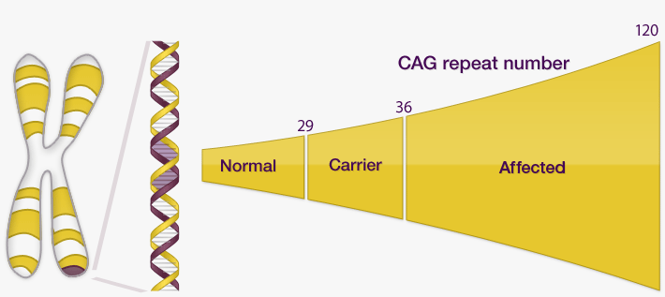
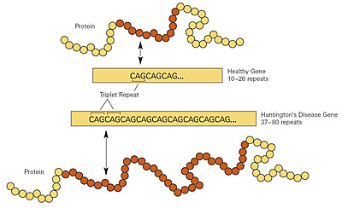
Ziekte van Huntington
Neurodegeneratieve genetische aandoening
Erft autosomaal (chr 4) dominant over
Tast hersenen aan (onwillekeurige bewegingen, verstandelijke achteruitgang, psychische problemen)
Eerste symptomen rond 40 jr, juveniele vorm ~15
http://biol1020-2012-1.blogspot.nl/2012/04/stem-cells-may-prove-to-be-possible.html
https://www.nist.gov/news-events/news/2011/04/new-nist-srm-helps-improve-diagnosis-huntingtons-disease

Slide 9
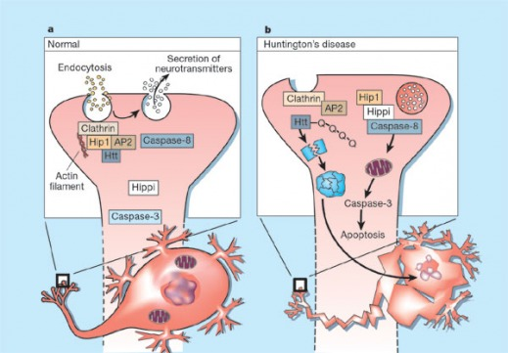
Ziekte van Huntington
normal huntingtin (Htt) binding Hip1, modulating endocytosis.
mutated Htt, which is cleaved by a complex formed by Hip1 and Hippi, forming an aggregate which eventually leads to apoptosis.
http://nickelsgen677s09.weebly.com/

Slide 10
Organisms use DNA-repair systems to counteract mutations
Proofreading (during replication)
Postreplication repair (just after replication)
Mismatch repair (just after replication)
Photoreactivation repair
Excision repair (base and nucleotide)
Double strand break repair: homologous recombination and non-homologous end joining
SOS-repair

Slide 11
Proofreading
Replication errors → 1 in 100.000 (pol III, bacteria)
After proofreading → 1 in 10.000.000
(dus 99 van de 100 fouten worden er direct weer uit gehaald)
Vraag
Welke enzymatische activiteit van polymerase III verzorgt deze proofreading?
De 3’-5’ exonuclease activiteit
Notes:
99 % wordt dus gerepareerd door proofreading
Which activity of polymerase does the proofreading?
3’-5’ exonuclease activiteit.
Mismatch repair, zelf opzoeken in boek!

Slide 12
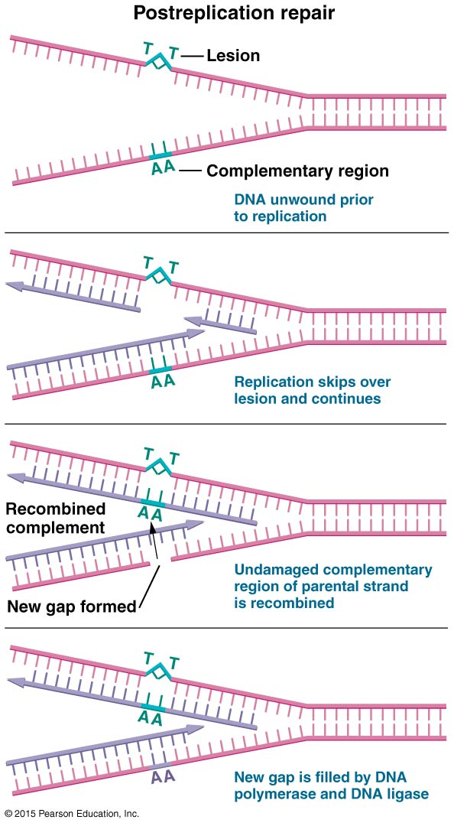
Post-replication repair
Homologous recombination repair, m.b.v. RecA
Stopt even en slaat een stuk over
RecA wisselt uit met andere streng
Ontstane gap wordt correct aangevuld

Slide 13
Mismatch repair
Mismatch repair for mistakes which are still there after replication (mutH,L,S in E. coli)
Vraag (zoek op in boek):
Herkenning:
How does the mismatch
repair mechanism know
which strand is the
correct one and which
needs repairing?
5’-GATC-3’
3’-CTAG-5’
CH3
CH3
DAM methylation: DNA Adenine methylase, nieuw gerepliceerde strengen zijn nog niet gemethyleerd

Slide 14
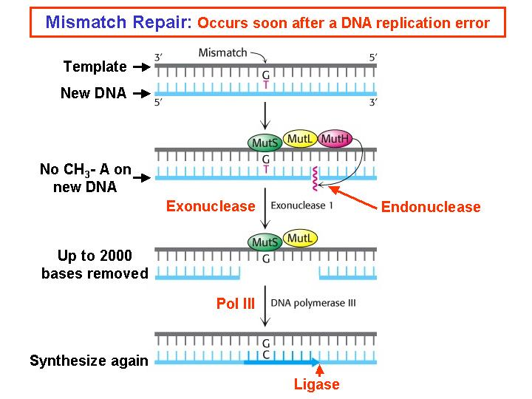
Mismatch repair
Werkwijze:
Endonuclease: nick, 5’ of 3’ van de mismatch (dus aan 1 kant)
Exonuclease: denaturatie en afbreken nicked streng, t/m mismatch
DNA-polymerase III: aanvullen
Ligase: dichtmaken
Notes:
Er wordt een flink stuk verwijderd en weer opnieuw ingevuld.

Slide 15
Organisms use DNA-repair systems to counteract mutations
Proofreading (during replication)
Postreplication repair (just after replication)
Mismatch repair (just after replication)
Photoreactivation repair
Excision repair (base and nucleotide)
Double strand break repair: homologous recombination and non-homologous end joining
SOS-repair

Slide 16
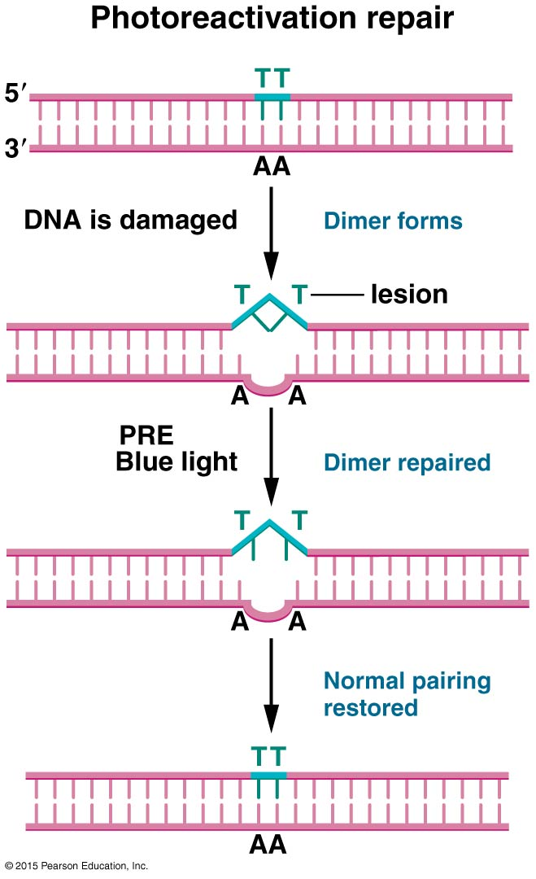
Photoreactivation repair
Photoreactivation repair enzyme (PRE), reversing UV-damage in E.coli.
Licht nodig!
PRE niet gevonden in de mens
Notes:
Bacteriën, schimmels, planten, vertebraten, niet in mens.
Enzym absorbeert blauw licht en kan met deze energie de schade ongedaan maken.
PRE-mutatie is niet lethaal.
Zonnebrandcreme met PRE (photolyase).

Slide 17
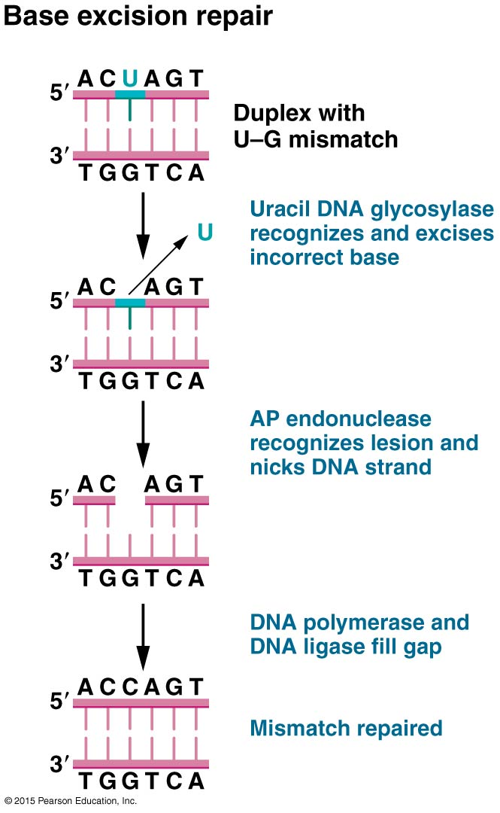
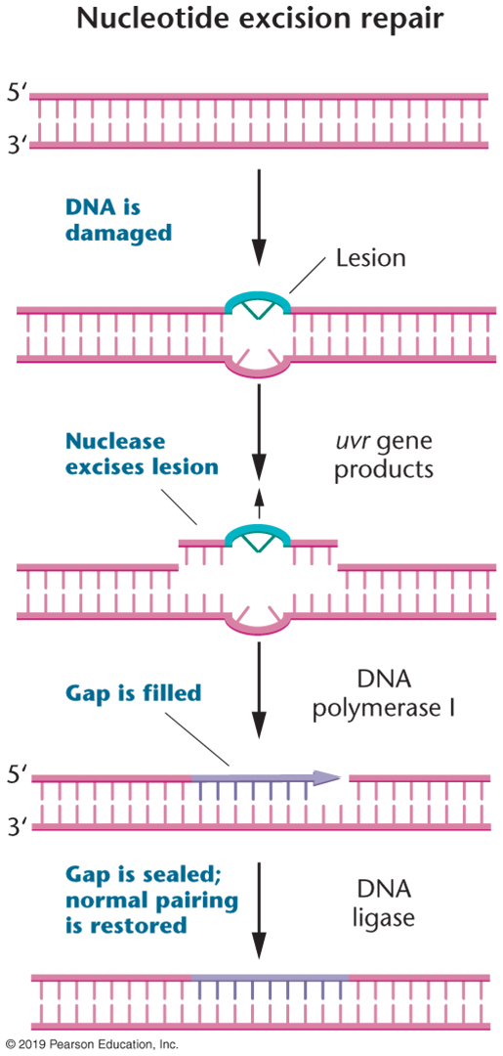
Excision repair (base or nucleotide)
Methylering al aangebracht, kan dus alleen als gemuteerde streng bekend is
← BER vs. NER →
E.coli 13 nt, euk. 18 nt

Slide 18

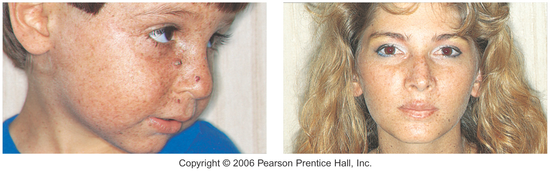

Xeroderma Pigmentosum
“Children of the Night”
Deficient in nucleotide excision repair (NER)
Notes:
Eukaryoten: 30 genen
Huidafwijkingen
Ontwikkeling en neurologische effecten.
2000 keer zo grote kans op kanker.
Lethaal, maar bescherming tegen zon helpt.
Fibroblasten, onderzoek naar UV-induced lesions repair.
Gestoord in: Unscheduled DNA-synthesis. Meerdere genen gemuteerd.

Slide 19
Xeroderma pigmentosum, onderzoek
Somatic cell hybridization to look for complementation,
To find out how many genes are involved in the process?
Fibroblast of
one patient
Fibroblast of
other patient
Heterokaryon,
waarin materiaal van
beide patienten zit.
Kunnen ze elkaar ‘helpen’ of niet?
7 complementation groups
Notes:
Cellen van twee verschillende patienten fuseren: heterokaryon.
Nu wel weer NER? Dan twee verschillende genen.
7 complementatiegroepen ontdekt, XPA tot XPG. En DNA polymerase H is laatste groep (20 % van de gevallen).
XPC, E en A herkennen de schade, dan komen B en D erbij die helicase activiteit hebben, F en G exonuclease, 28 nuc eruit geknipt.

Slide 20
Opdracht
Presented here are hypothetical findings from studies of heterokaryons formed from 7 human XP cell strains.
Which strains fall into the same complementation groups?
How many different groups are revealed based on these data?
What can we conclude about the genetic basis of XP from these data?
 | XP1 | XP2 | XP3 | XP4 | XP5 | XP6 | XP7
XP1 | -
XP2 | - | -
XP3 | - | - | -
XP4 | + | + | + | -
XP5 | + | + | + | + | -
XP6 | + | + | + | + | - | -
XP7 | + | + | + | + | - | - | -
+ = complementing; - = noncomplementing

Slide 21
Opdracht
Welke stammen horen bij dezelfde groep, en hoeveel groepen zijn er?
 | XP1 | XP2 | XP3 | XP4 | XP5 | XP6 | XP7 | XP8
XP1 | -
XP2 | + | -
XP3 | + | - | -
XP4 | - | + | + | -
XP5 | + | + | + | + | -
XP6 | + | - | - | + | + | -
XP7 | + | + | + | + | - | + | -
XP8 | - | + | + | - | + | + | + | -
Groep 1:
XP1, XP4, XP8
Groep 2:
XP2, XP3, XP6
Groep 3:
XP5, XP7
+ = complementerend; - = niet-complementerend

Slide 22
Organisms use DNA-repair systems to counteract mutations
Proofreading (during replication)
Postreplication repair (just after replication)
Mismatch repair (just after replication)
Photoreactivation repair
Excision repair (base and nucleotide)
Double strand break repair: homologous recombination and non-homologous end joining
SOS-repair

Slide 23
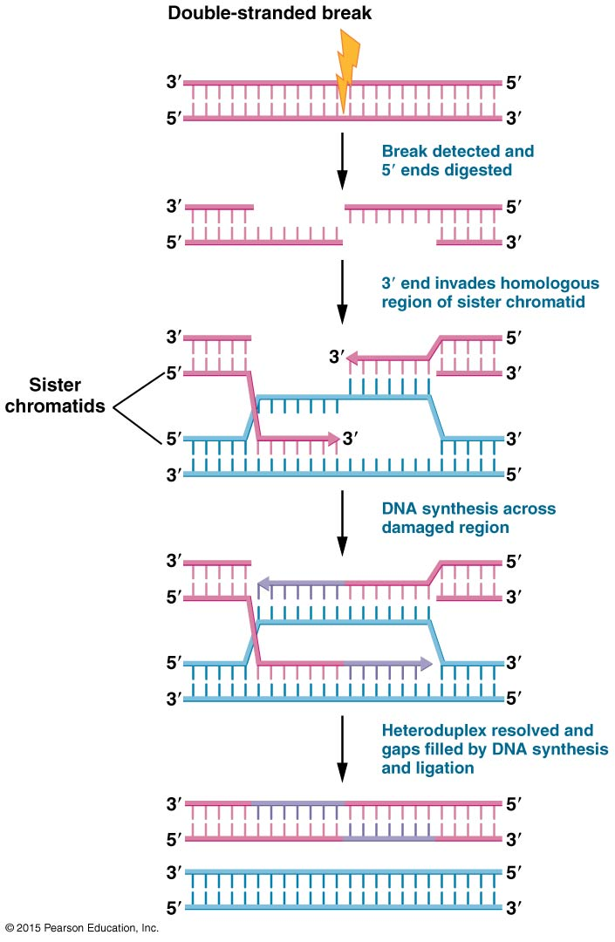
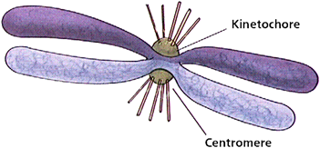
Double strand break repair, via homologous recombination
Kan alleen in de late S
of de vroege G2-fase
van de cel.
filmpje extra met uitleg
Notes:
Filmpje met uitleg: https://www.youtube.com/watch?v=86JCMM5kb2A
UV straling
Gevaarlijk, leidt tot chromosome rearrangements
Mutaties leiden tot X-ray hypersensitivity
http://www.ncbi.nlm.nih.gov/pubmed/11003700

Slide 24
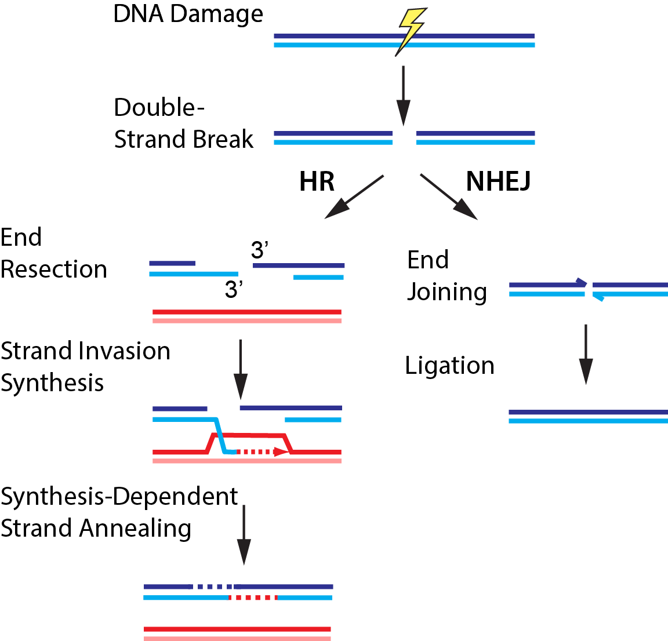
Double-strand break repair via homologous recombination (HR) and non-homologous end joining (NHEJ)
In G2-fase
In G1-fase
HR – Homologous Recombination
NHEJ – Non-Homologous End Joining
Filmpje extra NHEJ
http://finkelsteinlab.org/research
Notes:
Andere manier, met meer risico.
Er gaan wat nucleotiden verloren
Er kunnen chromosomen aan elkaar gezet worden die niet bij elkaar horen.
https://www.youtube.com/watch?v=31stiofJjYw

Slide 25
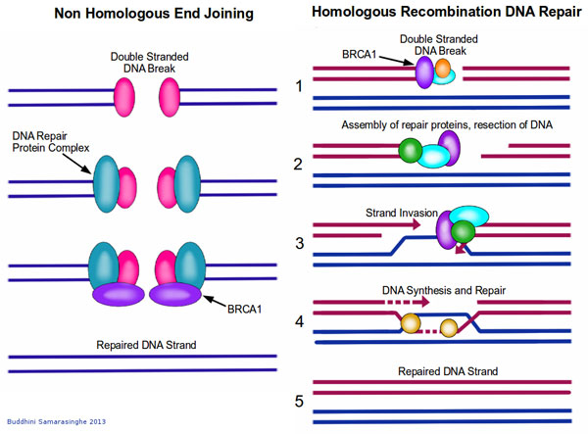
BRCA1 – Centrale rol in DNA repair
Betrokken bij homologous recombination en non-homologous end joining
Notes:
Molecular Caretakers: BRCA1 and BRCA2 Two of the most famous proteins in cancer, BRCA1 and BRCA2, play a central role in DNA repair. These proteins move to the site of DNA damage and recruit other proteins to initiate DNA repair complexes. When either BRCA1 or BRCA2 are absent as the result of a mutation, these DNA repair complexes do not form after DNA damage. Therefore, cells that are missing BRCA1 or BRCA2 are hypersensitive to agents that damage DNA, such as UV light and various chemical carcinogens. Women with an abnormal BRCA1 or BRCA2 gene, for example, have an extremely high risk of developing breast cancer and a high risk of developing ovarian cancer.
Angelina Jolie, van 89% naar 5% kans op borstkanker.
BRCA1 is bij beide processen betrokken.

Slide 26
SOS repair system
Na te veel UV schade, te veel om te repareren
20 eiwitten in werking
DNA replicatie kan doorgaan
Random inserties op slechte stukken
Mutageen proces, maar wellicht wel overleven
Notes:
During normal growth, the SOS genes are negatively regulated by LexA repressor protein dimers. Under normal conditions, LexA binds to a 20-bp consensus sequence (the SOS box) in the operator region for those genes. Some of these SOS genes are expressed at certain levels even in the repressed state, according to the affinity of LexA for their SOS box. Activation of the SOS genes occurs after DNA damage by the accumulation of single stranded (ssDNA) regions generated at replication forks, where DNA polymerase is blocked. RecA forms a filament around these ssDNA regions in an ATP-dependent fashion, and becomes activated. The activated form of RecA interacts with the LexA repressor to facilitate the LexA repressor's self-cleavage from the operator.^{[3]}
Once the pool of LexA decreases, repression of the SOS genes goes down according to the level of LexA affinity for the SOS boxes. Operators that bind LexA weakly are the first to be fully expressed. In this way LexA can sequentially activate different mechanisms of repair. Genes having a weak SOS box (such as lexA, recA, uvrA, uvrB, and uvrD) are fully induced in response to even weak SOS-inducing treatments. Thus the first SOS repair mechanism to be induced is nucleotide excision repair (NER), whose aim is to fix DNA damage without commitment to a full-fledged SOS response.
If, however, NER does not suffice to fix the damage, the LexA concentration is further reduced, so the expression of genes with stronger LexA boxes (such as sulA, umuD, umuC - these are expressed late) is induced. SulA stops cell division by binding to FtsZ, the initiating protein in this process. This causes filamentation, and the induction of UmuDC-dependent mutagenic repair. As a result of these properties, some genes may be partially induced in response to even endogenous levels of DNA damage, while other genes appear to be induced only when high or persistent DNA damage is present in the cell.

Slide 27
Organisms use DNA-repair systems to counteract mutations
Proofreading (during replication)
Postreplication repair (just after replication)
Mismatch repair (just after replication)
Photoreactivation repair
Excision repair (base and nucleotide)
Double strand break repair: homologous recombination and non-homologous end joining
SOS-repair

Slide 28
Stability versus Alterations
Genetic stability is essential for accurate development, cellular functions, and the passage of traits to offspring. In summary, essential for preserving a species.
But… several genome altering forces are present, mutations, rearrangements, transposons.
Why ?
Creating diversity!!!

Slide 29
Opdracht
What is the correct order of enzymes used by the Mismatch Repair System
Exonuclease
Fosfatase
Endonuclease
Transferase
Exonuclease
Polymerase
Endonuclease
Exonuclease
Polymerase
Ligase
Kinase
Lyase
Exonuclease
Polymerase
Notes:
Rood

Slide 30
Opdracht
Describe 2 ways in which a T_T dimer can be repaired
Notes:
Online: op whiteboard

Slide 31
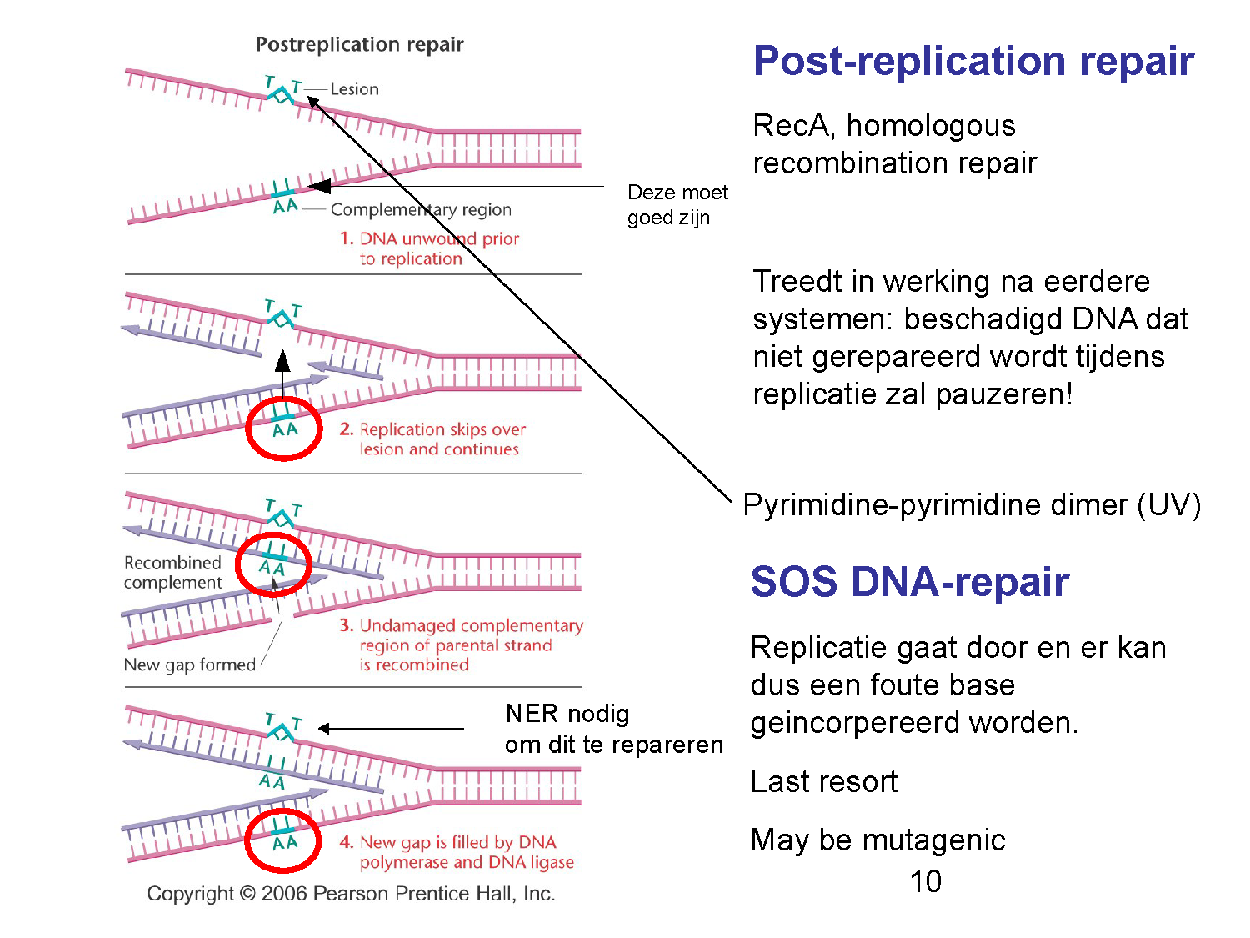
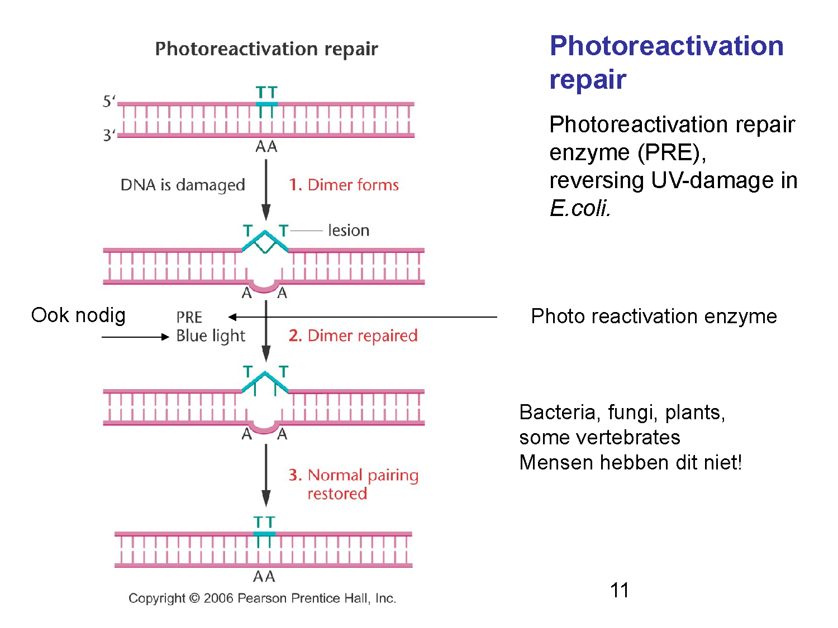
Describe 2 ways in which a T_T dimer can be repaired
!

Slide 32
Transposable elements Transposons, movable genes, jumping genes
In prokayoten en eukaryoten
Bijna 50% van humane genoom bestaat uit transposons
Functie niet bekend
Gereedschap voor genetisch onderzoek (introductie genen, merkers kloneren)
→ Kunnen leiden tot mutaties

Slide 33
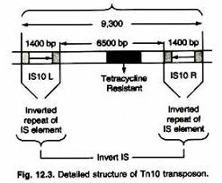
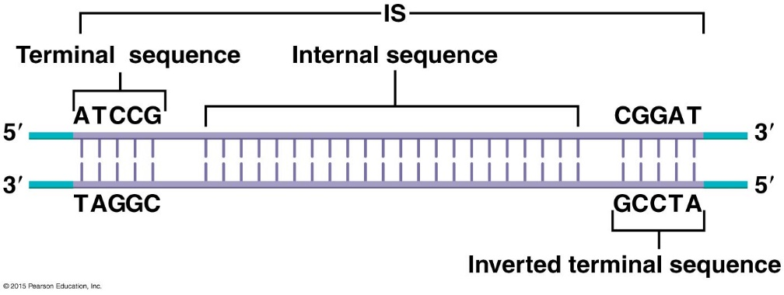
Transposable elements in bacteria
Insertion sequences (IS elements), < 2000bp, contain transposase, inverted terminal repeats (ITRs)
Bacterial transposons (Tn elements), Larger than IS elements, contain other gene besides transposase, 2 ITRs
http://www.biologydiscussion.com/cell/prokaryotes/transposable-genetic-elements-in-prokaryotes-2/12001

Slide 34
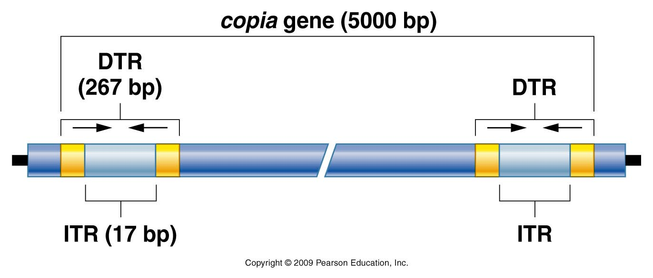
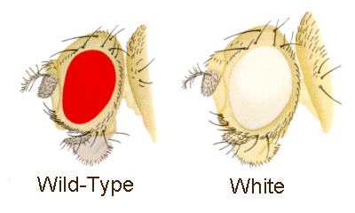
Transposable elements in Drosophila
P elementen: 0.5 - 2.9 kb lang, met 31 bp ITRs, coderen een transposase en een transposase inhibitor
Copia elementen: 5 – 8 kb lang, met 276 bp DTR (direct terminal repeat) waarbinnen een ITR
Notes:
Eye-color mutation white contains a copia element within the gene.

Slide 35
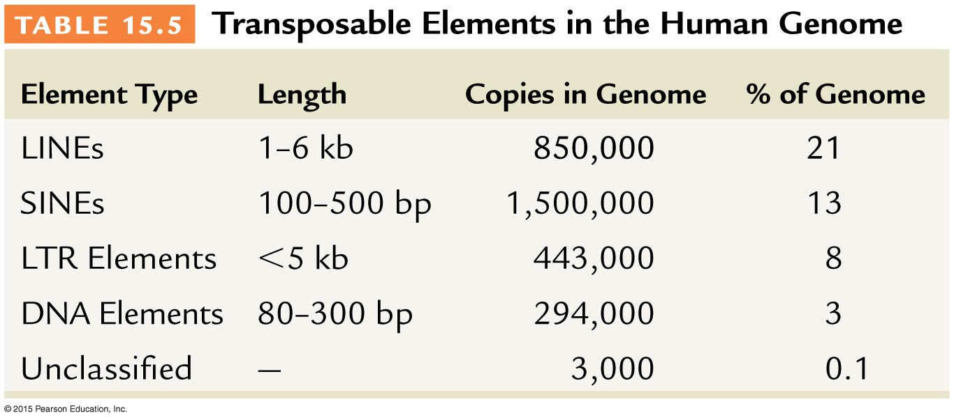
Transposable elements in humans
LINES- long interspersed elements
SINES- short interspersed elements
Deze LINES/SINEs worden in verband gebracht met o.a. hemofilie, dystrofie, borst- en colonkanker

Slide 36
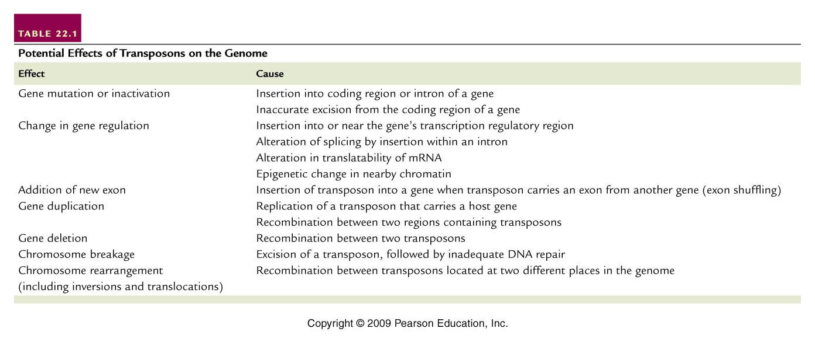
Effects of transposons

Slide 37
DNA transposons Retrotransposons
Bv. Tn elementen
Coderen transposase
Bevatten ITRs
Worden geflankeerd door repeterend DNA (target-site duplications)
DNA transposons verplaatsen zich door knippen/plakken of door kopiëren/plakken
Bv. copia, LINEs, SINEs
Verplaatsen zich via RNA intermediair
Hebben reverse transcriptase nodig
Bevatten elementen van retrovirussen
Retrotransposons verplaatsen zich altijd door kopiëren/plakken

Slide 38
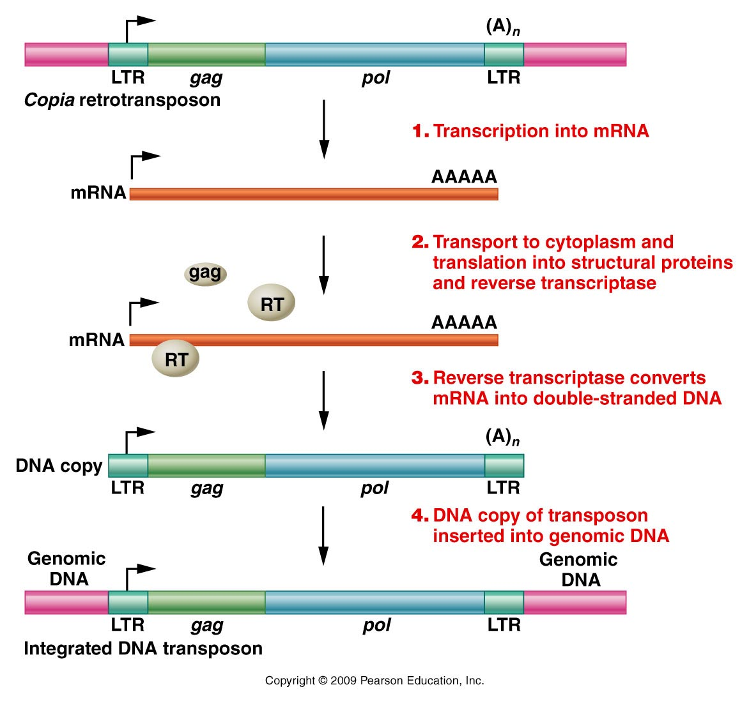
Retrotransposon transposition (copy/paste)

Slide 39
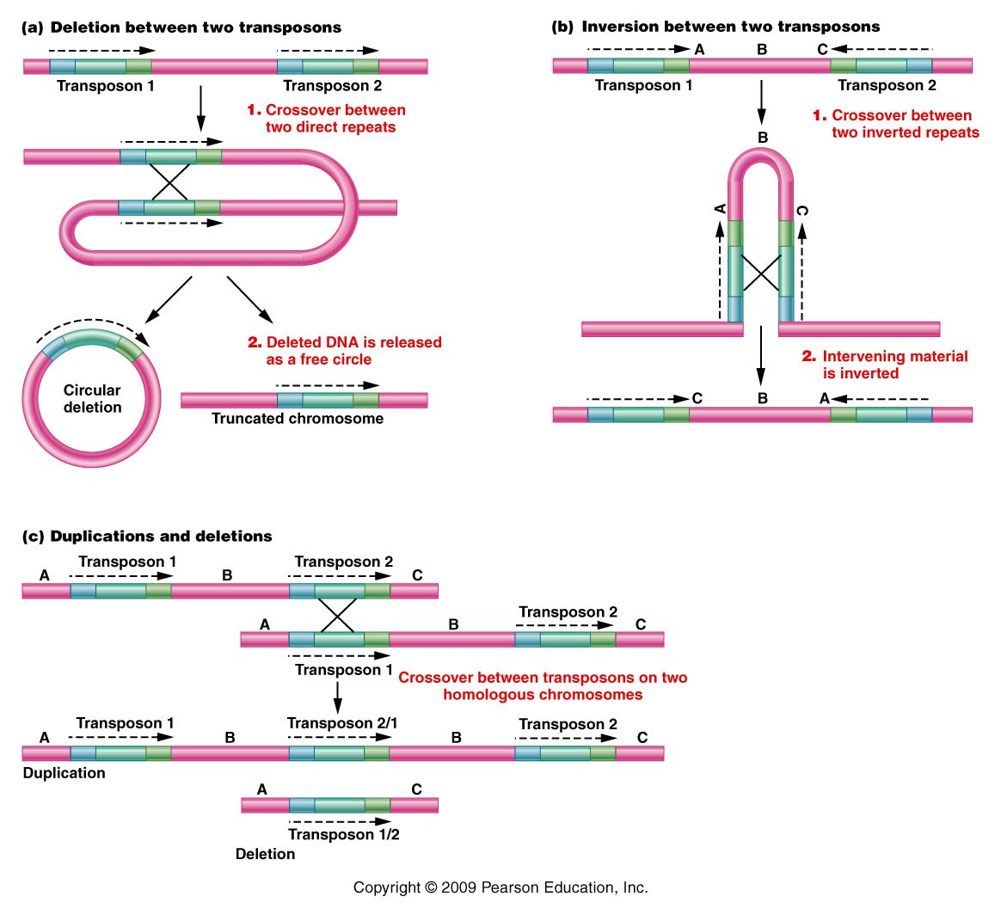
What can happen to the genome when 2 identical transposable elements are close together?

Slide 40
Transposon silencing
Gelukkig zijn de meeste transposons niet actief als gevolg van mutaties of door regulatie van de gastheer (bv. cytosine methylatie → condensatie chromosoom
Filmpje: transposons in het kader van evolutie
Notes:
http://www.youtube.com/watch?v=_Ol492CLkdY

